Slide 1
MACHINE LEARNING
Cement Strength Identification
Mentor: Alex Pak
Done by: Turak D.
Ormanov M.
Aksubaev A.

Slide 2
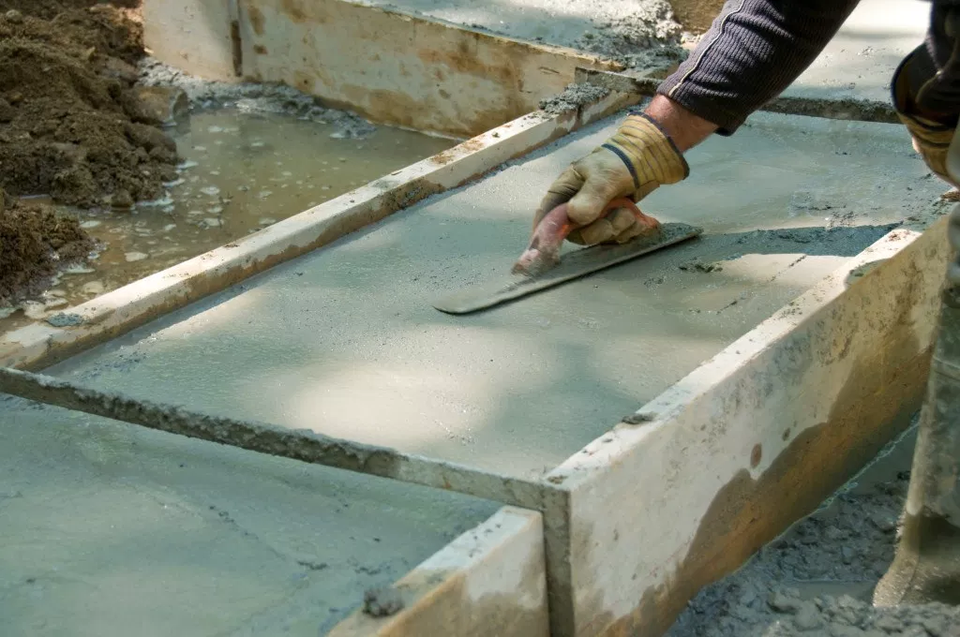
Problem
Concrete is important material in civil engineering and it is important to predict its strength depending on composition and age
The function of strength of concrete from those parameters is complicated one

Slide 3
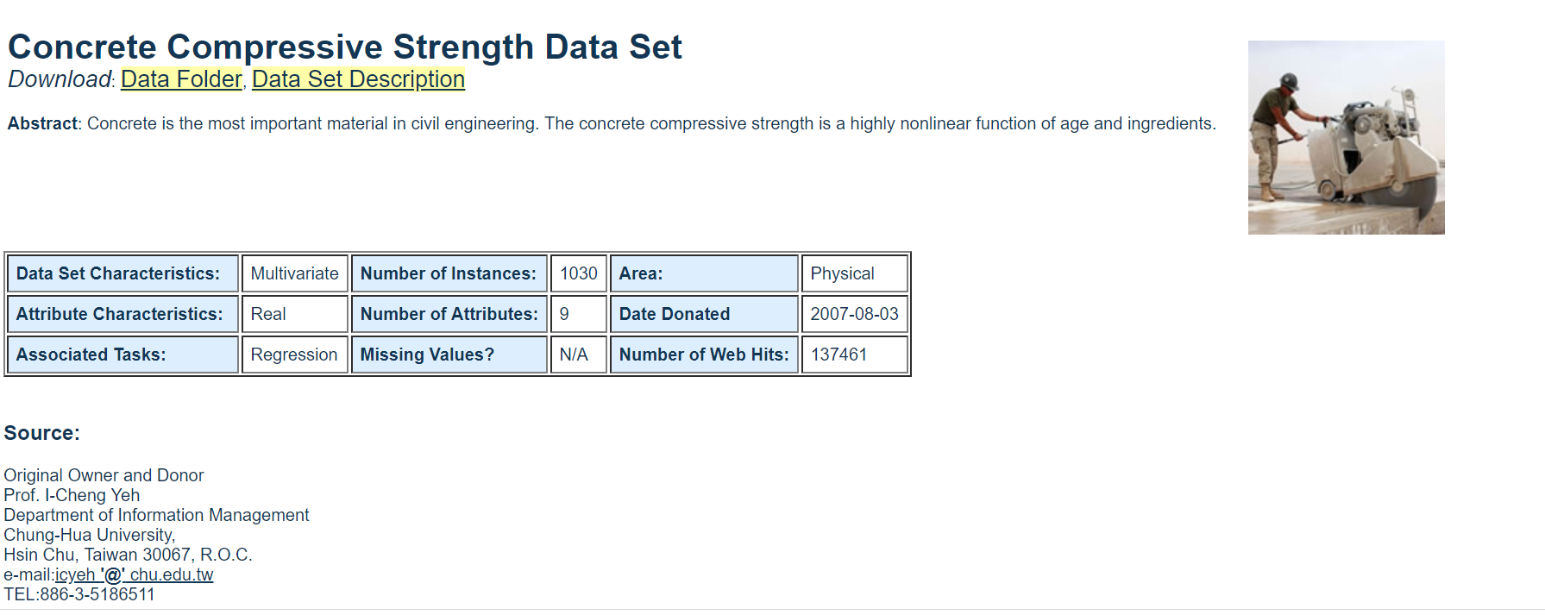
Dataset
We are going to use “Concrete Compressive Strength Data Set” from UCI Machine Learning Repository
https://archive.ics.uci.edu/ml/datasets/Concrete+Compressive+Strength

Slide 4
Solution
Dataset has 1030 instances with 9 attributes: 7 components, age and strength
- Those attributes are: cement, blast furnace slag, fly ash, water,
superplasticizer, coarse aggregate, fine aggregate measured in
kg per m3, age measured in years and concrete compressive
strength measured in MPa
We are going to use several machine learning algorithms/methods to teach computer to predict strength by first 8 attributes

Slide 5
Comparison
The given dataset is famous one so we are going to find other solutions to this problem and compare them to our and try to improve our result

Slide 6
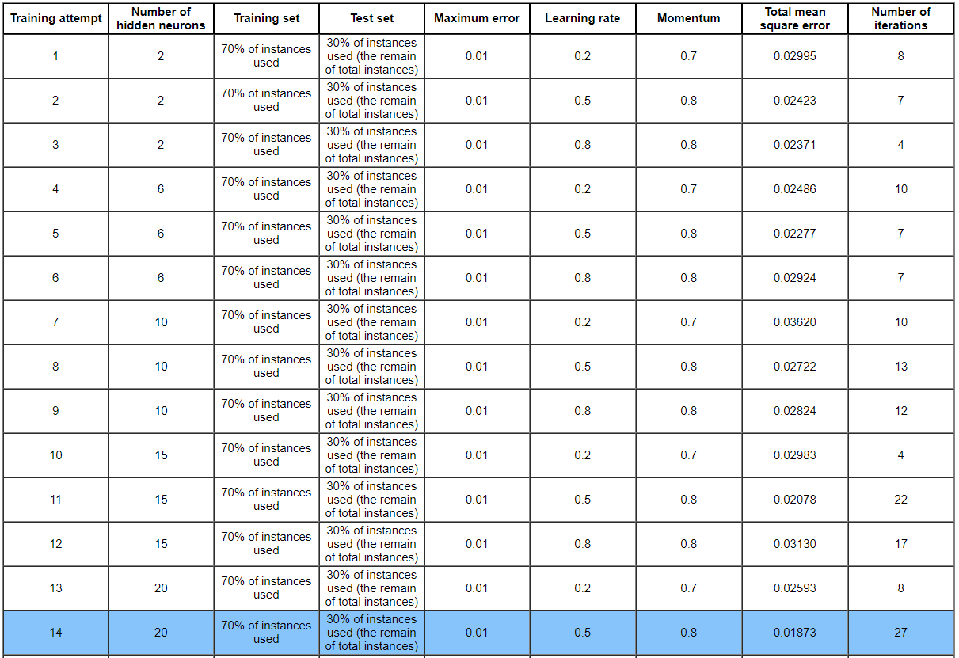
Comparison

